Slide 1


Keys in RDBMS

Slide 2


Lecture Checklist
Introduction to Keys in RDBMS.
Super Key.
Candidate Key.
Primary Key.
Foreign Key.
Alternate Key.
Composite Key.
Artificial Key.

Slide 3

Introduction to Keys in RDBMS

Slide 4
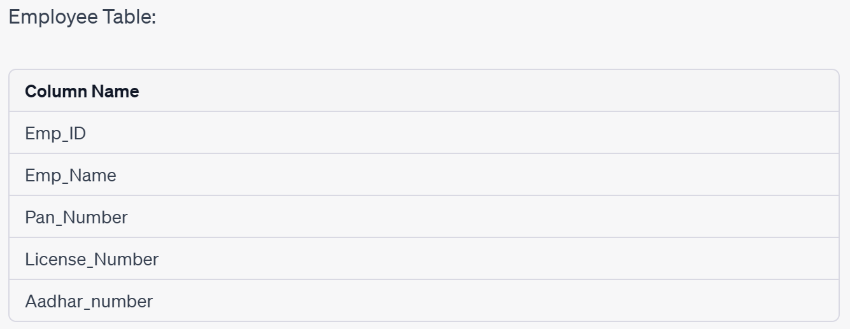
Super Key

Slide 5
Candidate Key
What is candidate Key?

Slide 6
Candidate Key
How is it different from super key?

Slide 7
Primary Key

Slide 8
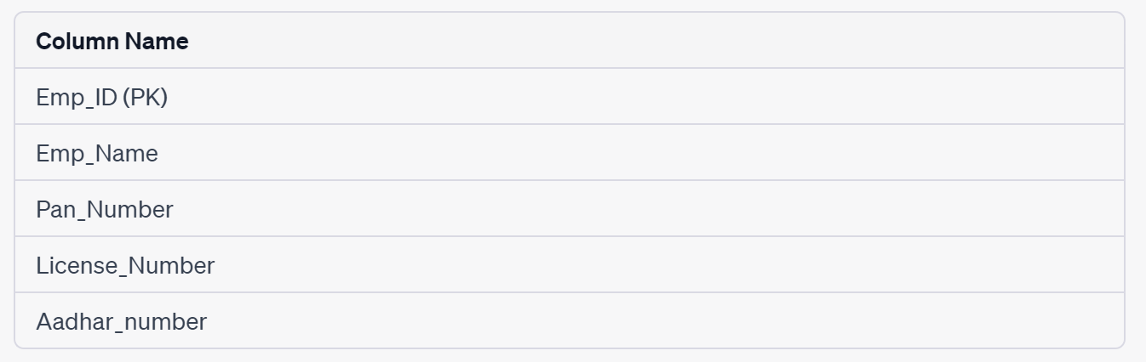
Primary Key

Slide 9
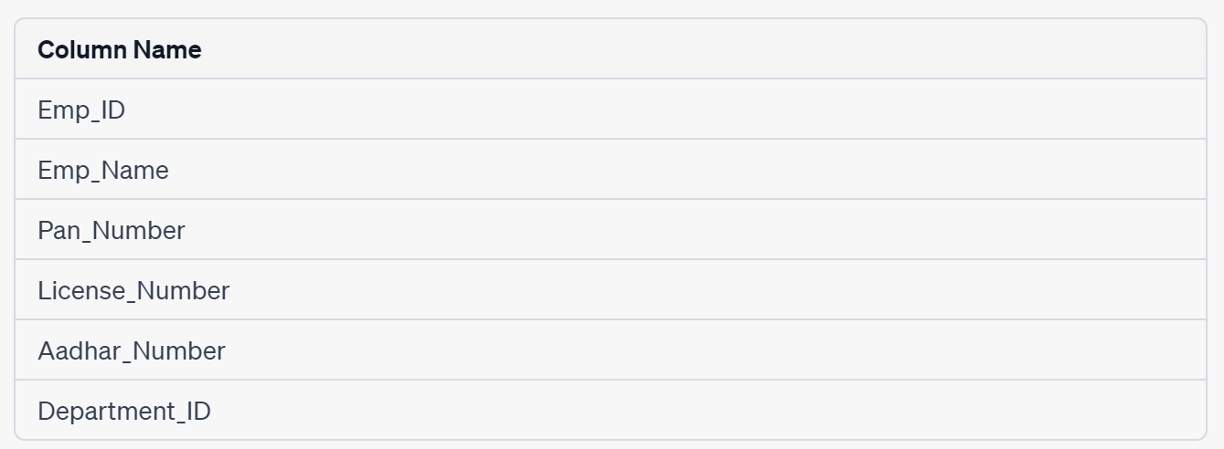
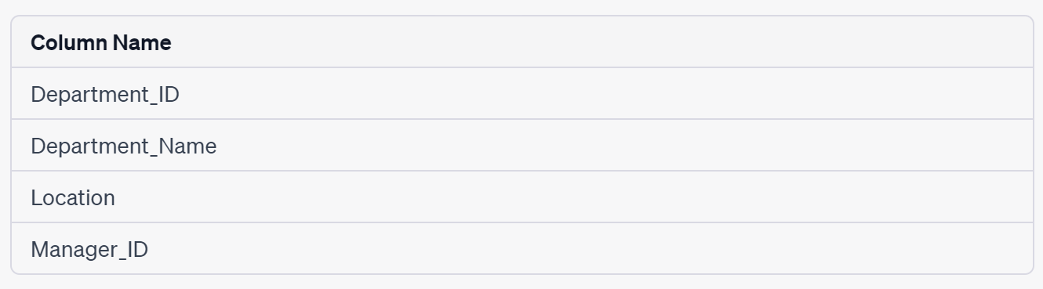
Foreign Key

Slide 10
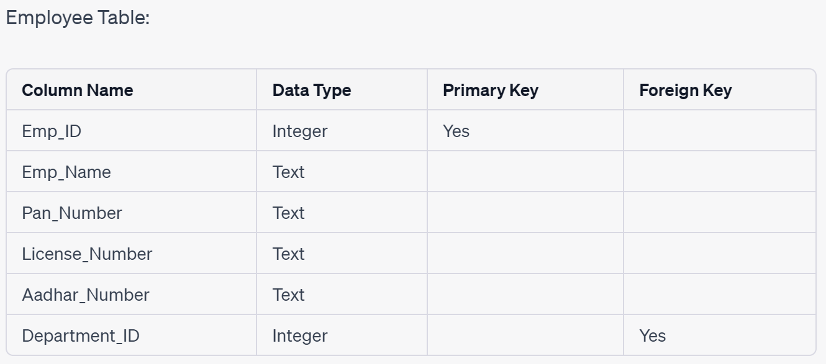
Foreign Key

Slide 11

Alternate Key

Slide 12
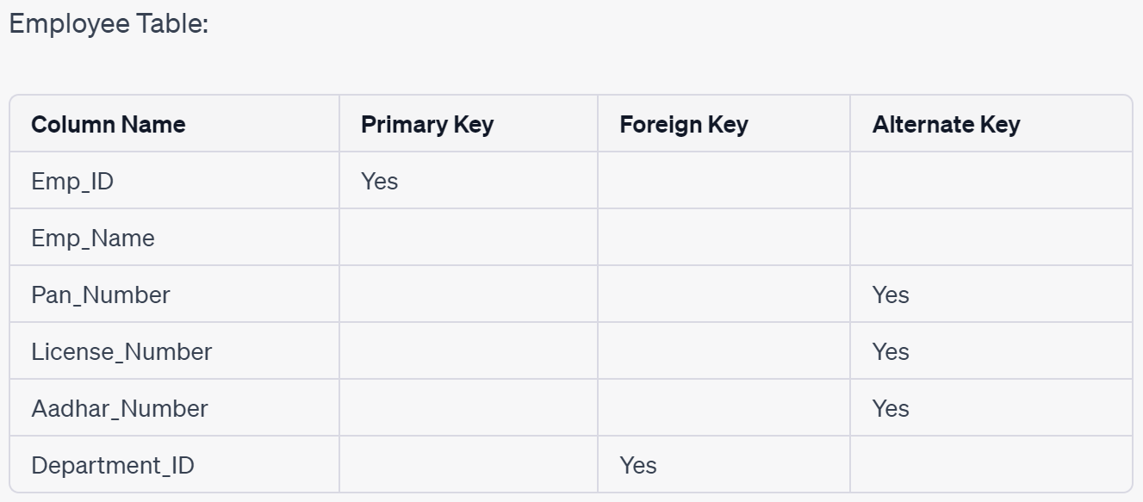
Alternate Key

Slide 13
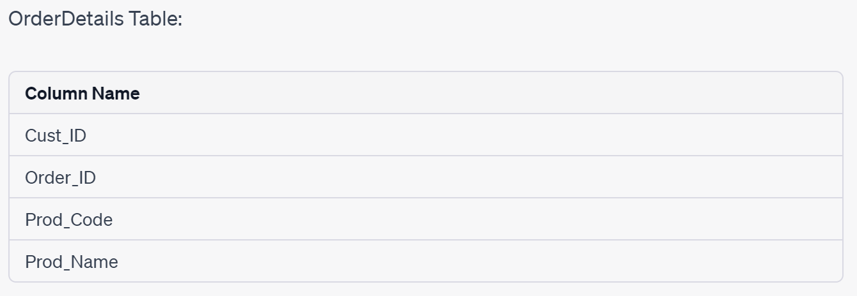
Composite Key

Slide 14
Artificial Key

Slide 15
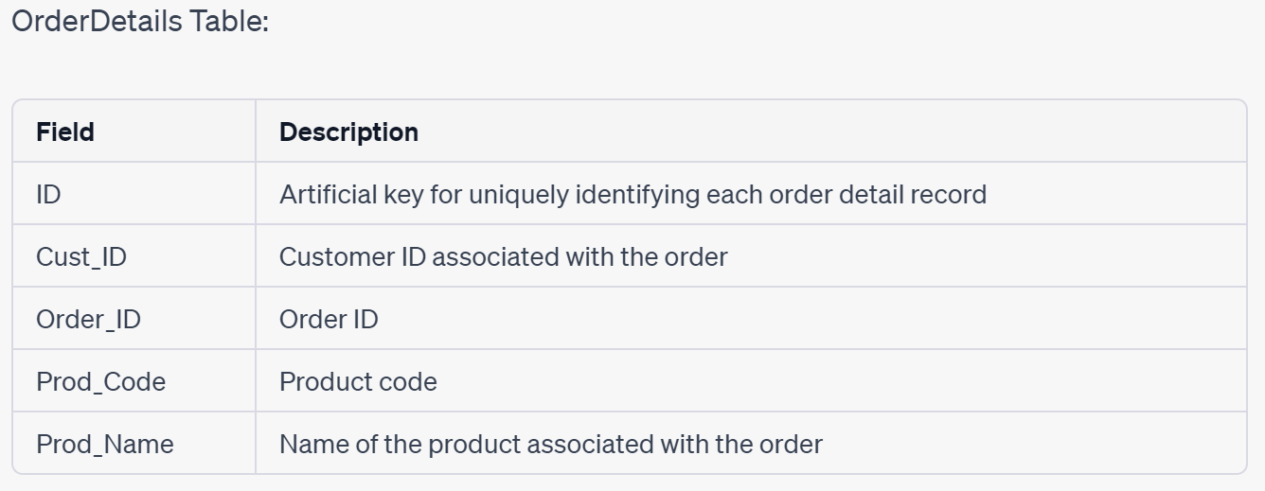
Artificial Key

Slide 16
THANK YOU

